Slide 1

ReliaTech GmbH
LYVE-1, CD45, and CD31 staining on frozen sections (5µm) of the mouse prostate
The experiments were performed by Scott Gerber & Edith Lord, PhD, University of Rochester, USA.
http://www.reliatech.de / orders@reliatech.de

Slide 2
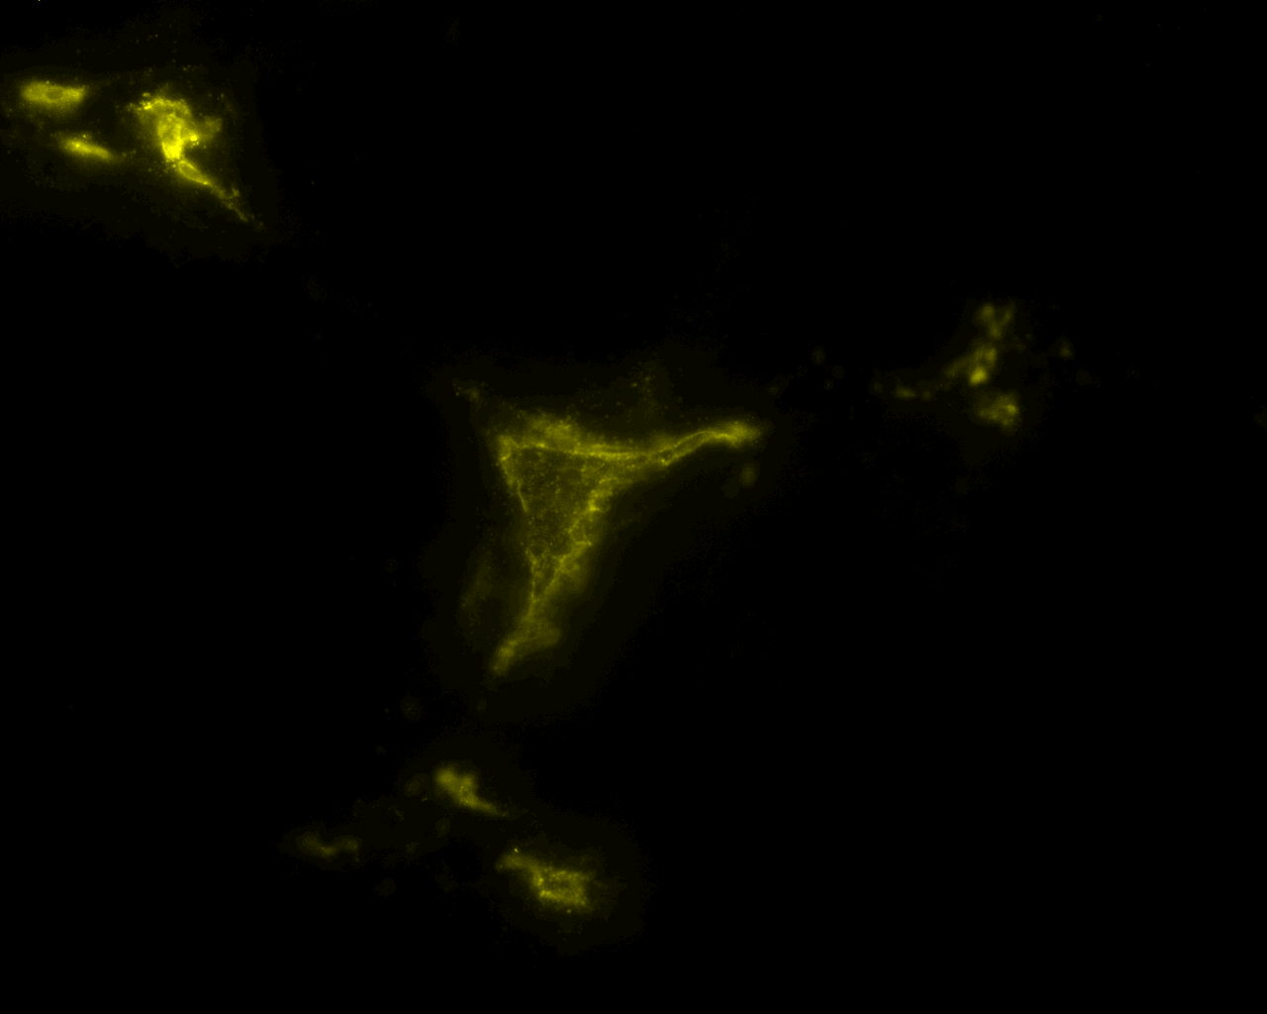
Slide 2: A section of the prostate stained for anti-LYVE-1 (yellow). This image illustrates a cross section of a small portion of a lymphatic shown in yellow in the middle (arrow).
25 microns
Notes:
SLIDE 2: A section of the prostate stained for anti-LYVE-1. A complete protocol can be found below. This image illustrates a cross-section of a small portion of a lymphatic shown in yellow in the middle (arrow). The other staining could be other lymphatics, or cells within the prostate that are also positive for LYVE-1. Our lab, as well as a number of other labs, has determined that other cell types also express LYVE-1. In the prostate, macrophage-like cells that are dispersed along blood vessels express LYVE-1.

Slide 3
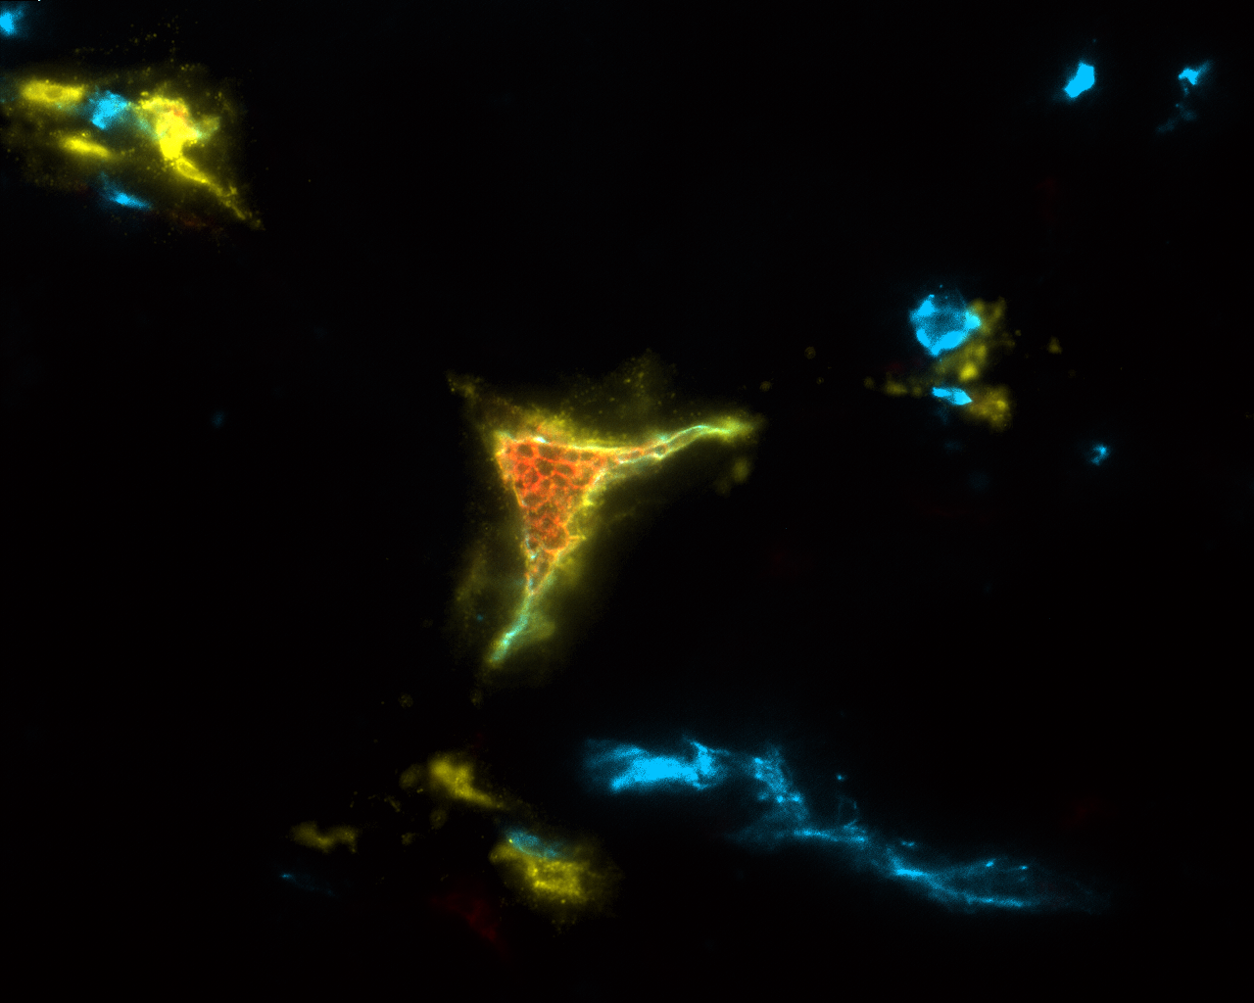
Slide 3: Same area as in slide 2, but overlaid where immune cells (red) and blood vessels (blue) are found within the LYVE-1 (yellow) stained image.A section of the prostate stained for anti-LYVE-1.
25 microns
Notes:
SLIDE 3: The same area as in slide 2, but now we have overlaid where immune cells (red), and blood vessels (blue) are found within the LYVE-1 stained image (this was accomplished using 3-color fluorescent microscopy on the same field and overlaying all 3 images together using Image Pro Plus software). As illustrated, immune cells (red-CD45 stained) are found within the lymphatic cross-section (arrow) giving credence to the antibody recognizing a true lymphatic that contains immune cells. Note that the blood vessels (blue-CD31 stained) are not positive for LYVE-1. It should be noted that lymphatic vessels are CD31 positive, but to a much lesser extent then blood vessels.

Slide 4
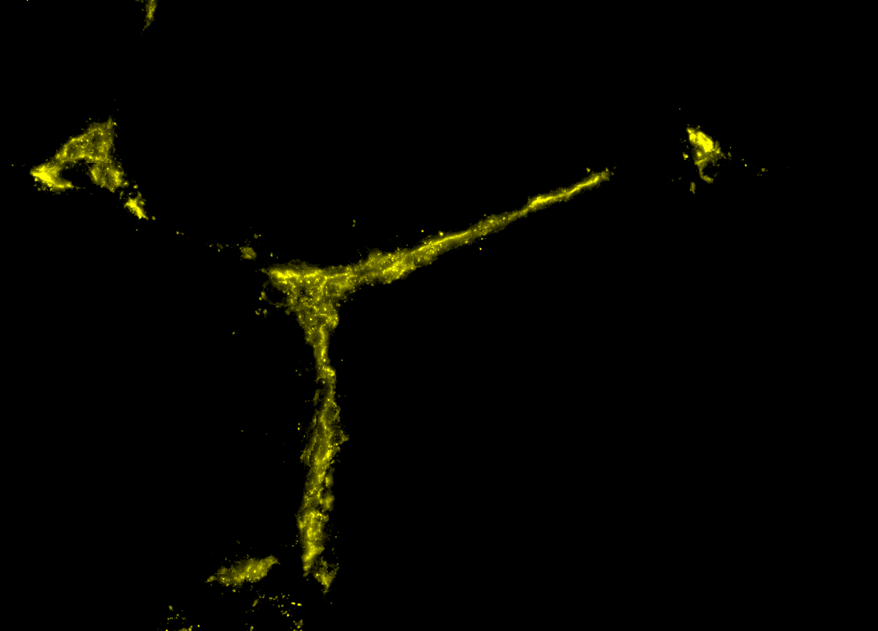
Slide 4: Another section of prostate stained for LYVE-1 (yellow) showing elongated lumen like structures reminiscent of a lymphatic vessel.
25 microns
Notes:
SLIDE 4: Another section of the prostate stained for LYVE-1 showing elongated lumen like structures reminiscent of a lymphatic vessel.

Slide 5
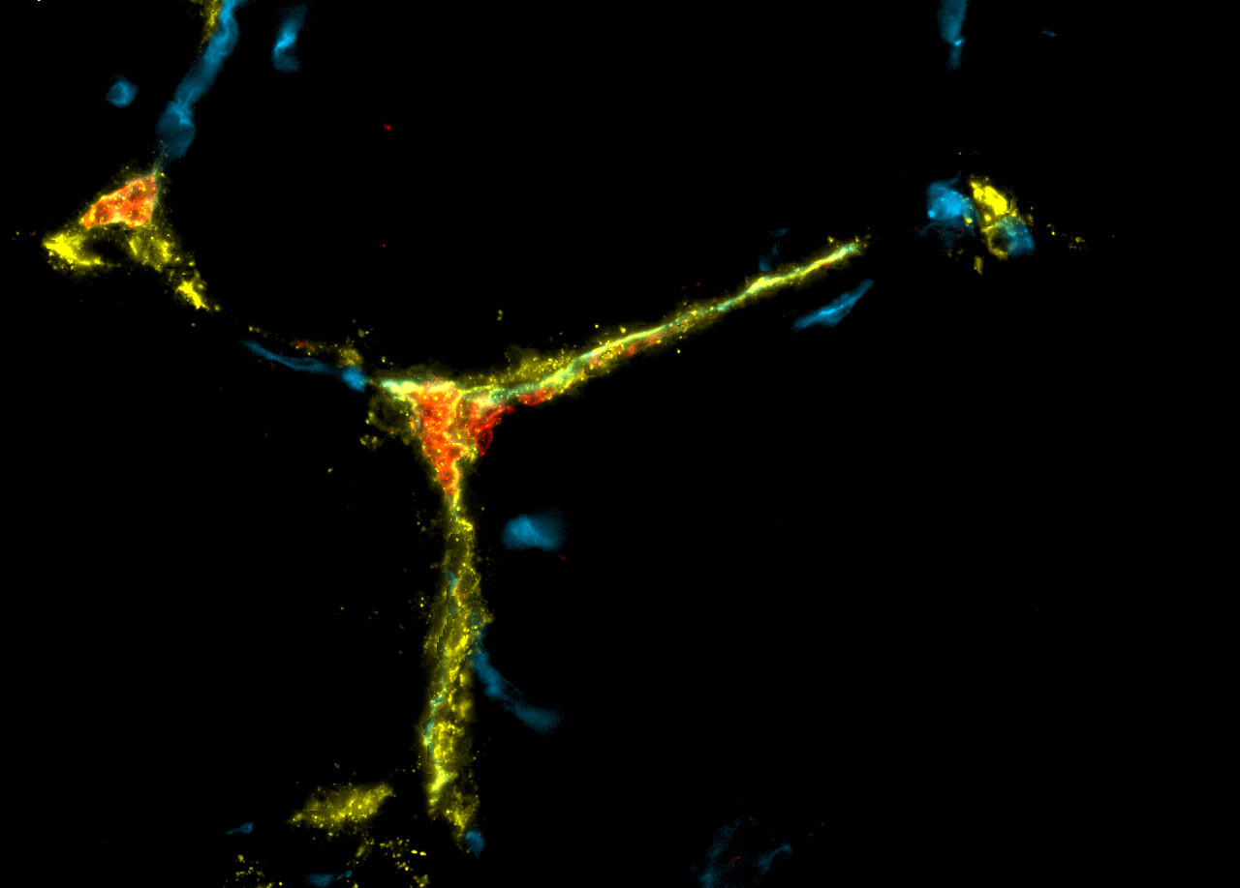
Slide 5: An overlay of immune cells (red) and blood vessels (blue) within the same field as in slide 4. The immune cells can be seen within the lumen of the LYVE-1 (yellow) lymphatic vessel structure.
25 microns
Notes:
SLIDE 5: An overlay of immune cells (red) and blood vessels (blue) within the same field as in slide 4. Again, immune cells can be seen within the lumen of the LYVE-1 lymphatic vessel structure, along with a few blood vessels scattered throughout the rest of the section.

Slide 6
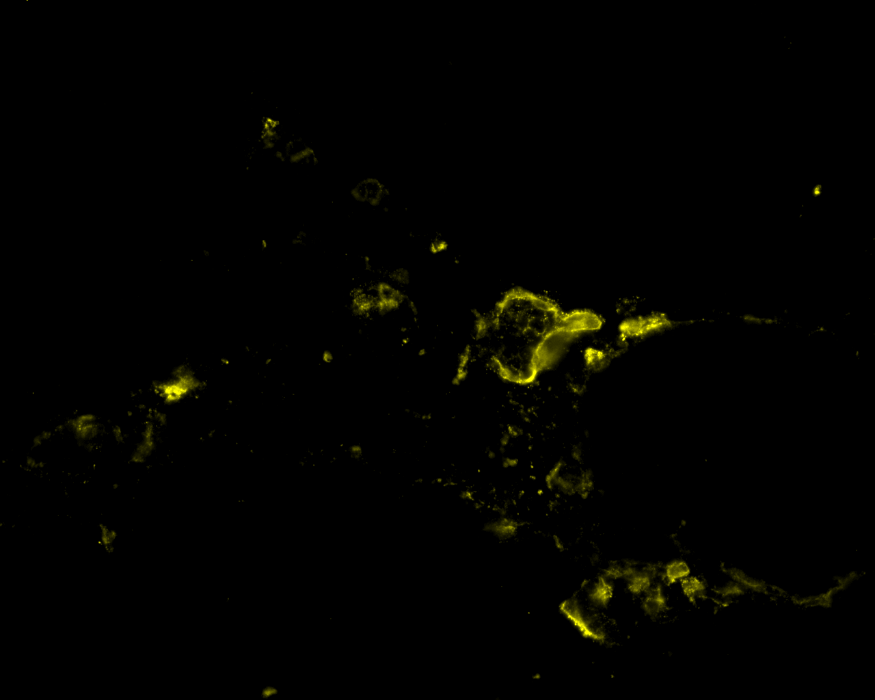
Slide 6: A section of the prostate illustrating a cross-section of LYVE-1 (yellow) stained lymphatic vessels (arrow). The other staining could be the LYVE-1 positive mactophages.
25 microns
Notes:
SLIDE 6: A section of the prostate illustrating a cross-section of LYVE-1 stained lymphatic vessels (arrow). Again, the other staining could be the LYVE-1 positive macrophages.

Slide 7
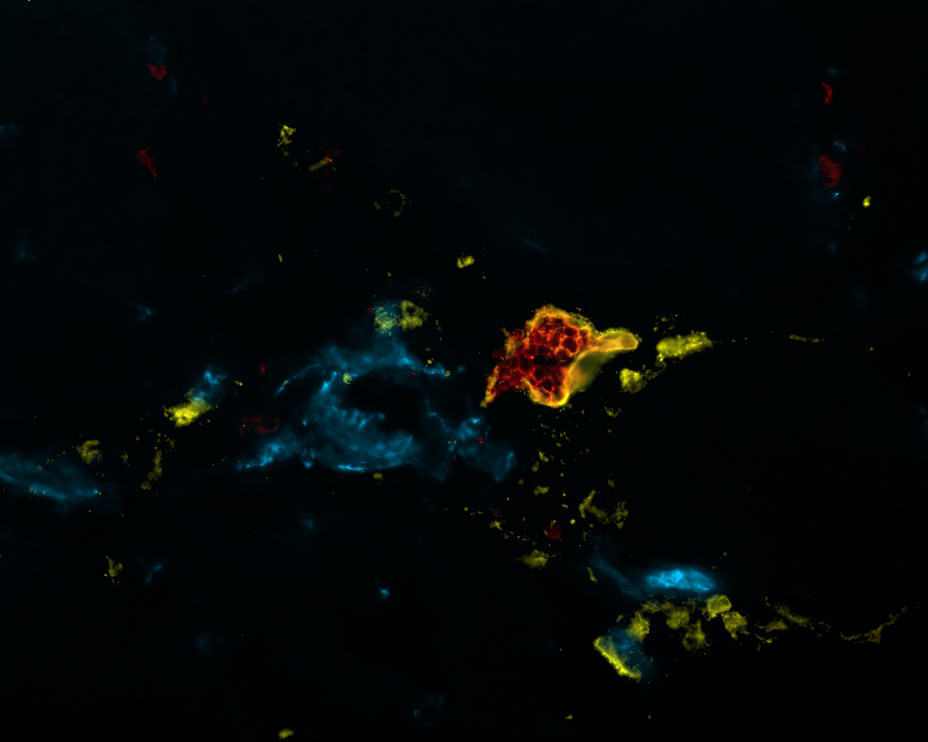
Slide 7: Overlay as slide 6, showing that the LYVE-1 (yellow) positive lymphatic vessel contains numerous immune cells (red) within ist lumen (arrow). Note the larger blood vessel (blue) to the left of the lymphatic, along with smaller ones below it.
25 microns
Notes:
SLIDE 7: Overlay as above, showing that the LYVE-1 positive lymphatic vessel contains numerous immune cells (red) within its lumen (arrow). Note the larger blood vessel (blue) to the left of the lymphatic, along with smaller ones below it.

Slide 8
Control for LYVE-1: 2nd alone

Slide 9
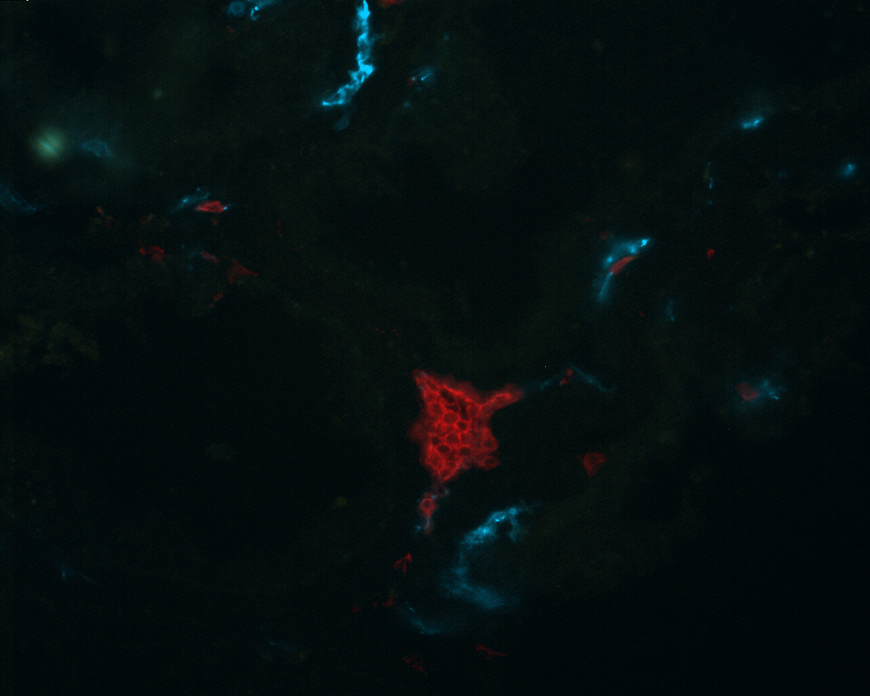
Slide 9: A serial section of the prostate similar to slide 1 & 2, but stained for immune cells (red), blood vessels (blue), ans secondary antibody only (no LYVE-1), and shown as a overlay of all 3 colors. As illustrated, no LYVE-1 staining can be found in this control depicting the specificity of the antibody.
25 microns
Notes:
SLIDE 9: A serial section of the prostate similar to slide 1 & 2, but stained for immune cells (red), blood vessels (blue), and secondary antibody only (no LYVE-1), and shown as an overlay of all 3 colors. As illustrated, no LYVE-1 staining can be found in this control depicting the specificity of this antibody.

Slide 10
LYVE-1and CD31 staining on whole mount samples of the mouse ear

Slide 11
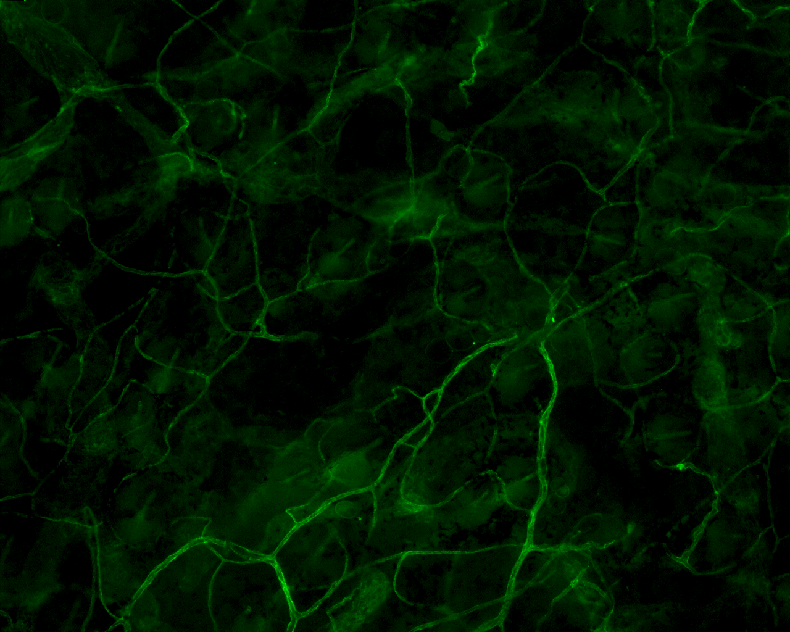
Slide 11: An image staind for CD31 (blood vessel - green) showing capillary structures and visualized using whole mount histology.
100 microns
Notes:
SLIDE 11: An image stained for CD31 (blood vessels—green) showing capillary structures and visualized using whole mount histology. A complete protocol is provided below.

Slide 12
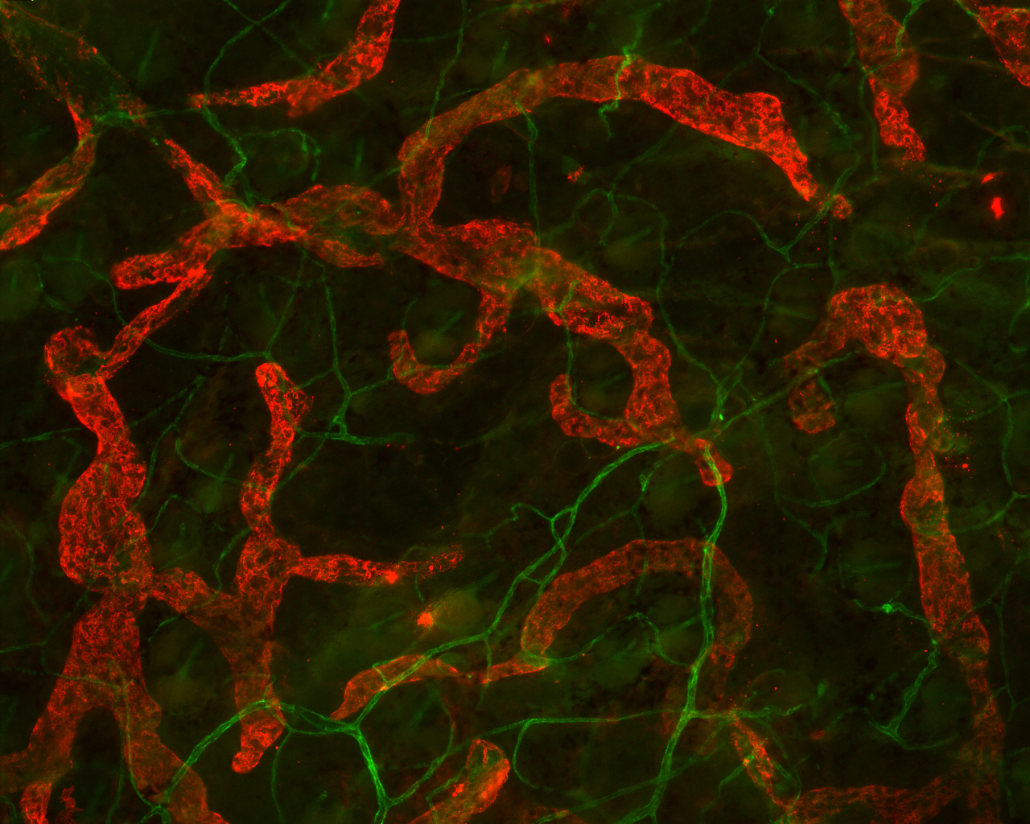
Slide 12: An image staind for CD31 (blood vessel - green) showing capillary structures and visualized using whole mount histology.
100 microns
Notes:
SLIDE 12: The same field as in slide 11, but now an image of the LYVE-1 positive lymphatic vessels (red) has been overlaid on the blood vessel image. Note how the lymphatic vessels are blunt ended vessels, and considerably larger in size compared to blood vessels. This is similar to the reported definition of a lymphatic vessel.

Slide 13
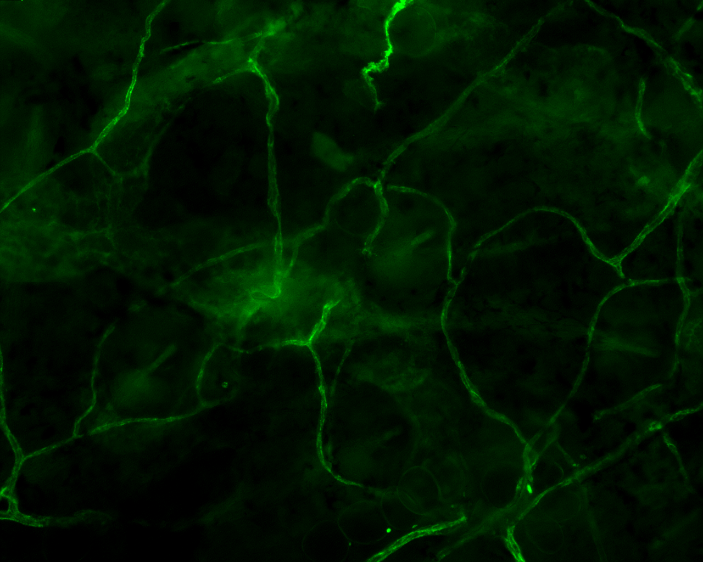
Slide 13: Similar to slide 11, but with higher magnification.
50 microns
Notes:
SLIDE 13: Similar to slide 11, but a higher magnification.

Slide 14
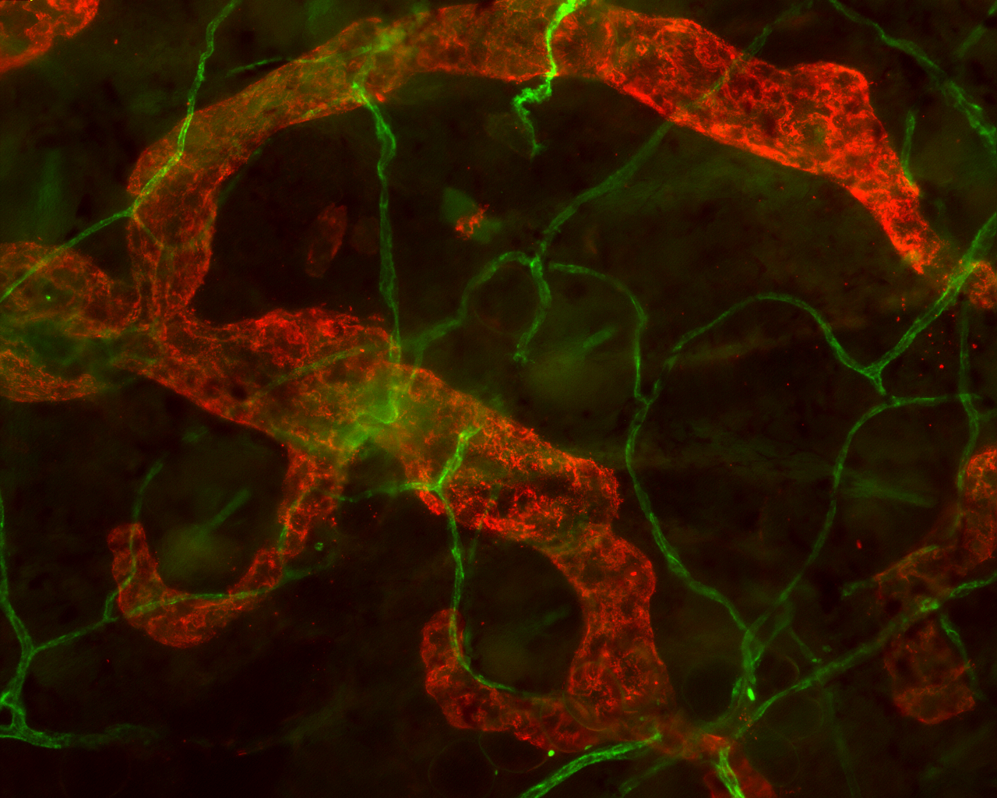
Slide 14: Similar to slide 12, but with higher magnification.
50 microns
Notes:
SLIDE 14: Similar to slide 12, but a higher magnification.

